Slide 1

Introduction to Computer Systems
Boolean Algebra
Direct Link to view these slides on Google Docs

Slide 2
What to expect in this topic:
Boolean, logic circuits and truth tables
Boolean formulas to Boolean circuits conversion
Boolean formulas to truth tables conversion
Difference between decoder and encoder

Slide 3
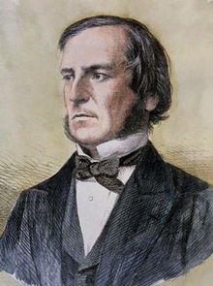
George Boole (1815 - 1864)
Developed Boolean algebra, algebraic operations only using 0 and 1 or false and true.
Born in Lincoln and essentially self taught in mathematics, he ultimately became professor at University College Cork.
His wife was a mathematician and one of their daughters was also a mathematician.

Slide 4
Electronic Circuits and Logic
Electronic circuits correspond to Boole’s rules of algebra
input output
and
not
0 0 0
1
0
0 1 0
1 0 0
[also ]
1 1 1
input output
or
input output
0 1
0 0 0
1 0
0 1 1
1 0 1
1 1 1
For more information on Boolean logic and circuits, please visit: https://www.youtube.com/watch?v=gI-qXk7XojA

Slide 5
Electronic Circuits and Logic
input output
A B C
0 0 0
0
A
0
0
0
B
0
0
0
0
C
0

Slide 6
Electronic Circuits and Logic
input output
A B C
0 0 0
0 0 1
0
0
A
0
1
0
B
0 1 0
1
1
1
1
0
C
0

Slide 7
Electronic Circuits and Logic
Note some alternative notations:
A
B
F
AB or
A·B or
A ∧ B
and
A
0 0 0
F
0 1 0
B
1 0 0
1 1 1
A
B
F
or
A
0 0 0
F
0 1 1
A + B or
A ∨ B
B
1 0 1
1 1 1
not
A
A
A
A
A or A’
0 1
1 0

Slide 8
Computer Anatomy
In the AND gate F is 1 only if all the inputs are 1.
F
In the OR gate F is 0 only if all the inputs are 0.
F

Slide 9
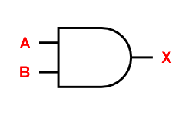
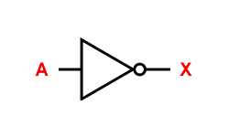
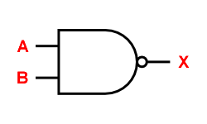
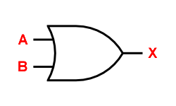
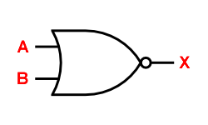
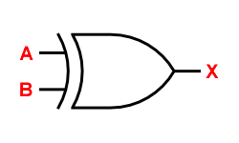
Logic Gates and Truth Tables
AND
A | B | X
0 | 0 | 0
0 | 1 | 0
1 | 0 | 0
1 | 1 | 1
A | B | X
0 | 0 | 1
0 | 1 | 1
1 | 0 | 1
1 | 1 | 0
NOT
NAND
A | X
0 | 1
1 | 0
X = A.B
X = Ā
X = A.B
NOR
XOR
OR
A | B | X
0 | 0 | 0
0 | 1 | 1
1 | 0 | 1
1 | 1 | 1
A | B | X
0 | 0 | 0
0 | 1 | 1
1 | 0 | 1
1 | 1 | 0
A | B | X
0 | 0 | 1
0 | 1 | 0
1 | 0 | 0
1 | 1 | 0
X = A + B
X = A + B
X = A ⊕ B

Slide 10
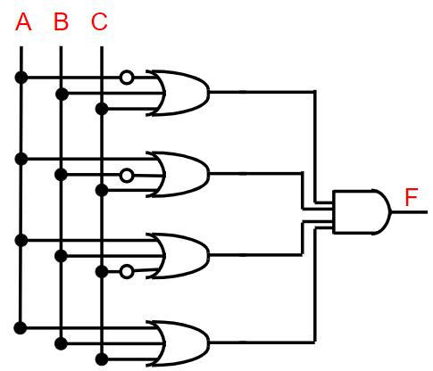
Computer Anatomy
F = (A + B + C) (A + B + C) (A + B + C) (A + B + C)

Slide 11
Computer Anatomy
F = (A + B + C) (A + B + C) (A + B + C) (A + B + C)
A B C (A + B + C) (A + B + C) (A + B + C) (A + B + C) F
0 0 0
1
1
1
0
0
0 0 1
1
1
0
1
0
0 1 0
1
0
1
1
0
0 1 1
1
1
1
1
1
1 0 0
0
1
1
1
0
1 0 1
1
1
1
1
1
1 1 0
1
1
1
1
1
1
1
1
1
1 1 1
1
Try yourself with :
F = (B C) + (A C) + (A B C)

Slide 12
We Can Make Any (Boolean) Circuit
A B C D
Split multiple outputs into one truth table for each output
0 0 0 0
0 0 1 0
input output
0 1 0 0
A B C D E
0 1 1 1
1 0 0 0
0 0 0 0 0
1 0 1 1
0 0 1 0 1
1 1 0 1
A B C E
0 1 0 0 1
1 1 1 1
0 1 1 1 0
0 0 0 0
1 0 0 0 1
0 0 1 1
1 0 1 1 0
0 1 0 1
1 1 0 1 0
0 1 1 0
1 1 1 1 1
1 0 0 1
1 0 1 0
1 1 0 0
1 1 1 1

Slide 13
Boolean Algebra Laws
Name | AND Form | Or Form
Identity Law | 1A = A | 0 + A = A
Null Law | 0A = 0 | 1 + A = 1
Idempotent Law | AA = A | A + A = A
Inverse Law | AĀ = 0 | A + Ā = 1
Commutative Law | AB = BA | A + B = B + A
De Morgan’s Law | A.B = A + B | A+B = A.B

Slide 14
We Can Make Any (Boolean) Circuit
A B C D
Take the lines where D is 1
each click adds one line
then simplify C common factor in first two terms
AB in second two terms and C+C’ is 1
0 0 0 0
0 0 1 0
0 1 0 0
0 1 1 1
1 0 0 0
1 0 1 1
1 1 0 1
1 1 1 1
D =
=
A’ B C + A B’ C + A B C’ + A B C
(A’B + AB’) C + A B

Slide 15
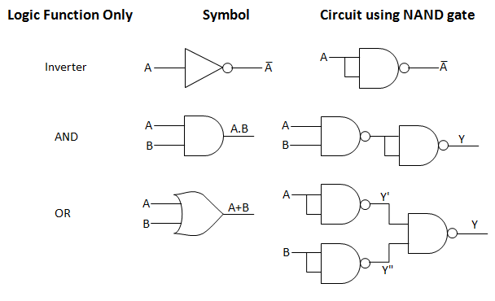
The NAND and NOR gates are universal gates
A universal gate is a gate which can implement any Boolean function without need to use any other gate type. The NAND and NOR gates are universal gates. In practice, this is advantageous since NAND and NOR gates are economical and easier to fabricate and are the basic gates used in all IC digital logic families
More about the universal gates :http://www.ccse.kfupm.edu.sa/~amin/eCOE200/Lesson2_6.pdf

Slide 16
Memory Elements: S-R Latch
S-R latch is a memory element
Depends on the timing of signals through the gate
Note that this is a NOR gate- the negation of OR
It holds the value of Q ( and Q’ )
when the R (Reset) input is charged, it will set Q to 0 and stay there
When S (Set) is charged, Q becomes 1 and stays there
When S input is 1, Q is set to 1 and remains with that value
What is the indeterminate state (not allowed)?
R
R S Q Q’
Q
0 0 1 0
1 0
0 1
0 0
0 1
Q’
0 1
1 0
S
0 0
1 0

Slide 17
A Decoder
F7
F6
decoder
F5
A2
F4
A1
F3
A0
F2
F1
F0

Slide 18
A Decoder
input output
A2 A1 A0 F7 F6 F5 F4 F3 F2 F1 F0
0 0 0 0 0 0 0 0 0 0 1
0 0 1 0 0 0 0 0 0 1 0
0 1 0 0 0 0 0 0 1 0 0
0 1 1 0 0 0 0 1 0 0 0
1 0 0 0 0 0 1 0 0 0 0
1 0 1 0 0 1 0 0 0 0 0
1 1 0 0 1 0 0 0 0 0 0
1 1 1 1 0 0 0 0 0 0 0
Use standard approach to get boolean function for each output
Will simplify so that: F0 = A2’A1’A0’
F1 = A2’A1’A0 etc

Slide 19
An Encoder
F7
F6
encoder
F5
A2
F4
A1
F3
A0
F2
F1
F0

Slide 20
An Encoder
Input Output
F7 F6 F5 F4 F3 F2 F1 F0 A2 A1 A0
0 0 0 0 0 0 0 1 0 0 0
0 0 0 0 0 0 1 0 0 0 1
0 0 0 0 0 1 0 0 0 1 0
0 0 0 0 1 0 0 0 0 1 1
0 0 0 1 0 0 0 0 1 0 0
0 0 1 0 0 0 0 0 1 0 1
0 1 0 0 0 0 0 0 1 1 0
1 0 0 0 0 0 0 0 1 1 1
In this case, Encoding is actually easier notice that only one input is ever on!
A0 = F1+F3+F5+F7
A1= F2+F3+F6+F7
A2 =F4+F5+F6+F7

Slide 21
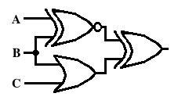
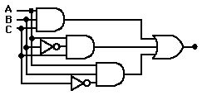
Homework
Q1: How does an encoder differ from a decoder?
Q2:Draw Decoder/Encoder inside logic circuit
Q3: What is the output of the following logical circuits?

Slide 22
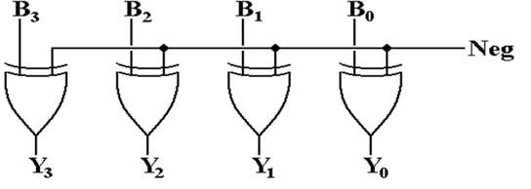
Homework
Q4: For the following logical circuit, Let B = 1011. If Neg = 0, what is the value of Y?
A. 1010
B. 0100
C. 1011
D. 0011

Slide 23
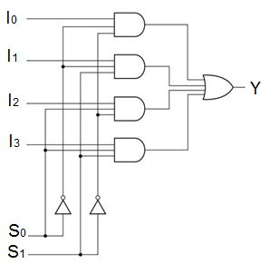
Homework
Q5: The following logic diagram is called 4-to-1 line multiplexer, what is the value of Y, if both S0 and S1 are 1?
A. I0
B. I1
C. I2 * I3
D. I1 + I2 + I3
E. I1 * I2
F. I3

